Slide 1
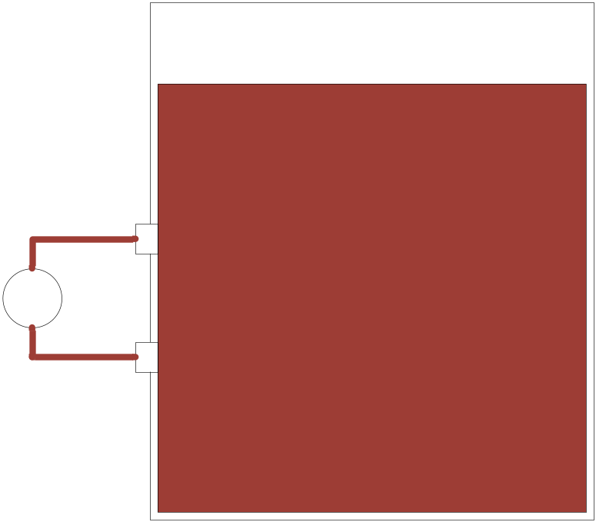
Measuring Density
First plan: measure pressure between two depths in the fermenter
It seems like such a simple idea
How do you clean it?
Fluid touches the sensor
Not good

Slide 2
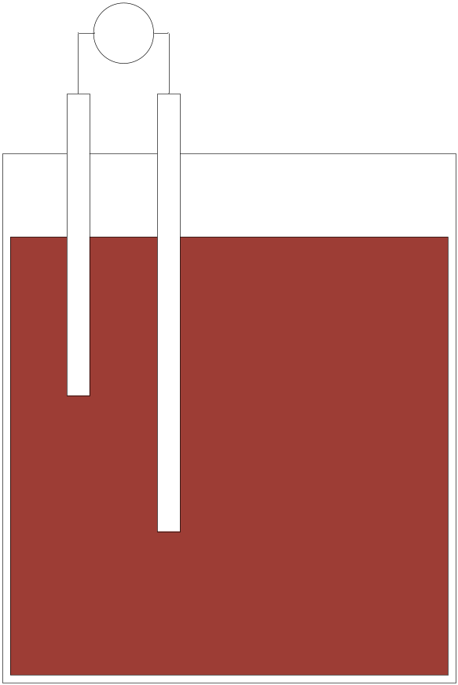
Next Density Step
Measure height of differential air column
Problem:
Pressure pushes fluid into
air column

Slide 3
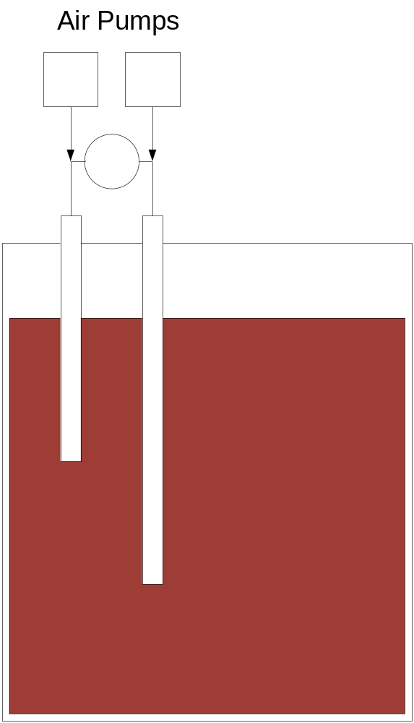
Air-supplied Tubes
Air pushes fluid out of each tube
Problem
Two holes in top of tank
Two pumps

Slide 4
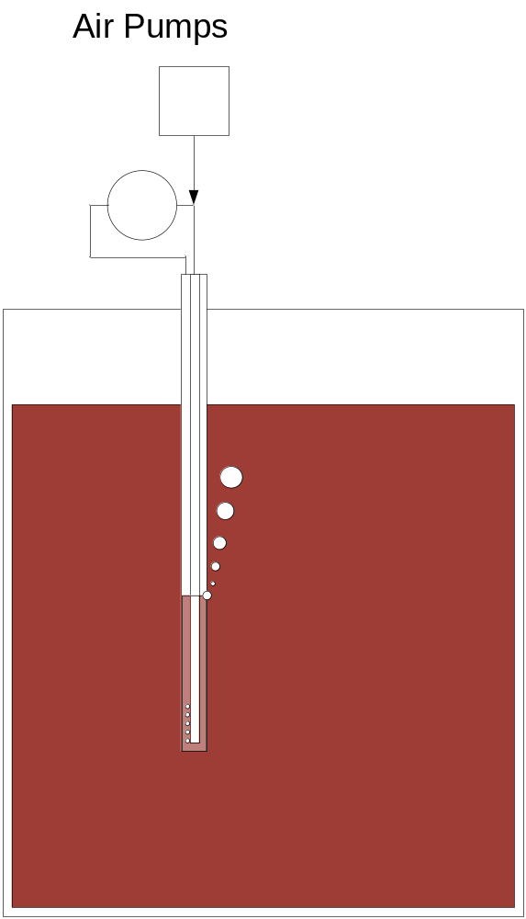
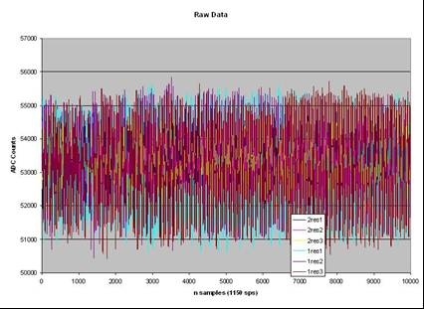
Single Tube – Single Pump
Simple arrangement . . . . but
  Discrete air bursts from pumps
  make noise larger than pressure
  differential to be measured

Slide 5
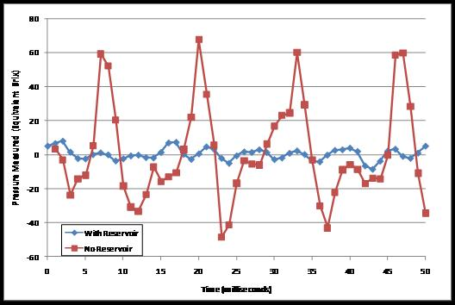
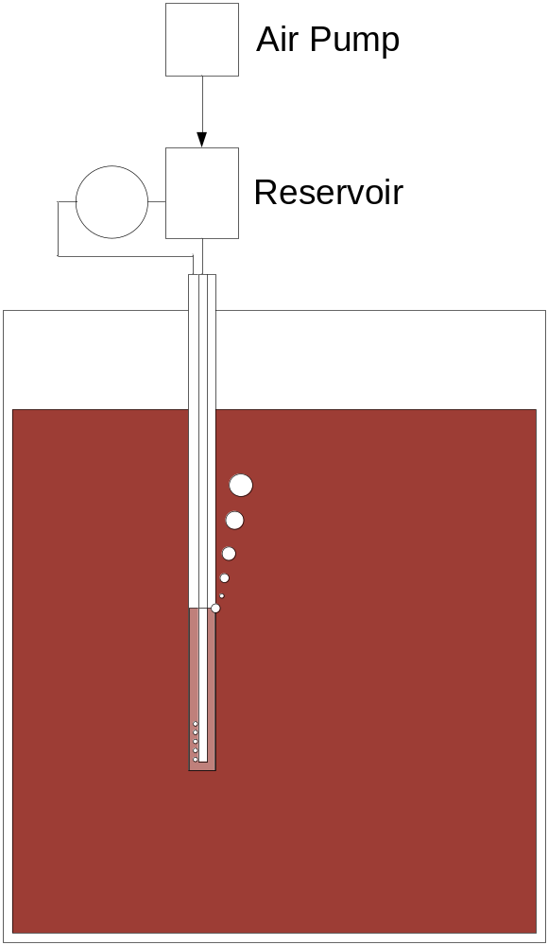
Mechanical “Filter”
Reservoir smoothes out pump noise
Target is +/- 0.5 Brix
Average bubbles for 30 sec to
get quiet measurement

